Slide 1
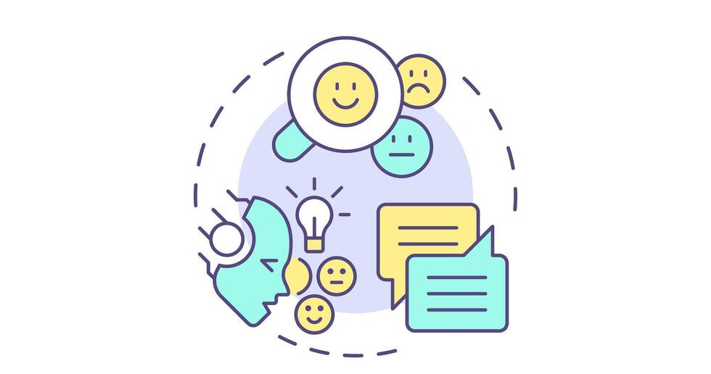
Dockerized Sentiment Analysis and Semantic Search
TUHIN MD ABU HAMZA
20233120013
Notes:
Good morning respected teacher and classmates.
My name is Tuhin Md Abu Hamza.
Today I am presenting my final project for the Professional Training course.
The project is about sentiment analysis and semantic search using transformer models and Docker.

Slide 2
Problem Statement
Understanding sentiment from text is difficult
Traditional methods lack context
Keyword search is limited
Deployment of ML systems is complex
Notes:
Sentiment analysis helps us understand opinions from text like reviews and feedback.
However, traditional methods cannot understand context very well.
Also, keyword-based search cannot find similar meaning texts.
Another challenge is deploying machine learning systems properly.

Slide 3
Project Objectives
Use transformer-based model
Perform sentiment analysis
Implement semantic search
Use vector database
Deploy with Docker
Notes:
The main goal of this project is to build a modern NLP (natural language processing) system.
I wanted to use a transformer model for sentiment analysis.
I also added semantic search using embeddings and a vector database.
Finally, I deployed everything using Docker.

Slide 4
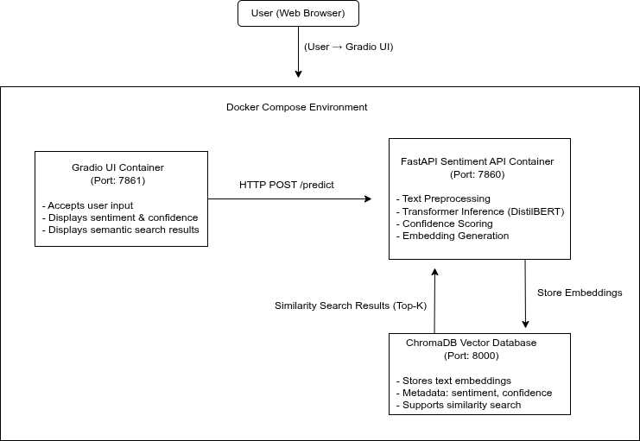
Overall System Architecture
Notes:
This slide shows the overall system architecture.
The user interacts with the system through a web interface.
The UI sends requests to the backend API.
The API runs the machine learning model and communicates with the vector database.
Each part runs in a separate Docker container.

Slide 5
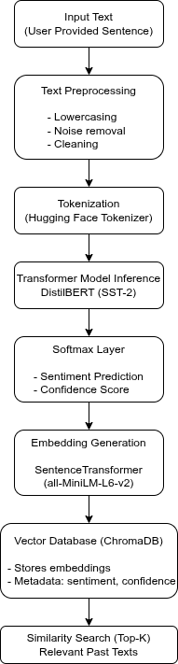
NLP and ML Pipeline
Text preprocessing
Tokenization
Sentiment prediction
Confidence score
Notes:
First, the input text is cleaned and preprocessed.
Then the text is tokenized and passed to the transformer model.
The model predicts whether the sentiment is positive or negative.
It also provides a confidence score for the prediction.

Slide 6
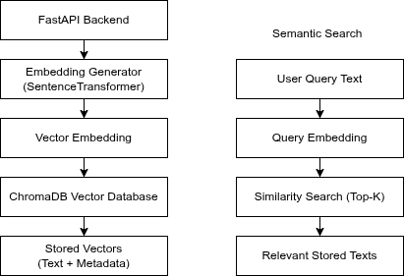
Semantic Search & Vector DB
Text preprocessing
Tokenization
Sentiment prediction
Confidence score
Notes:
After sentiment prediction, the system creates sentence embeddings.
These embeddings are stored in a vector database called ChromaDB.
When a user searches, the system finds similar texts based on meaning, not keywords.

Slide 7
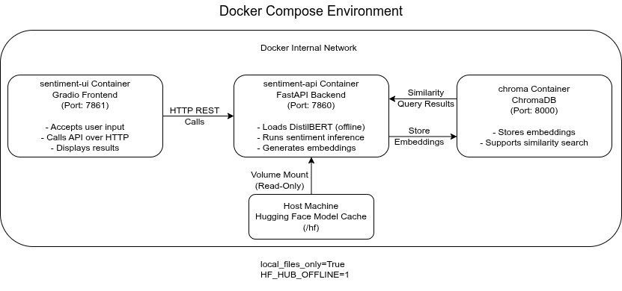
Docker Deployment
Notes:
The system is deployed using Docker Compose.
There are three containers: one for the API, one for the UI, and one for the vector database.
This makes the system easy to run and manage.
Docker also helps ensure the system runs the same everywhere.

Slide 8
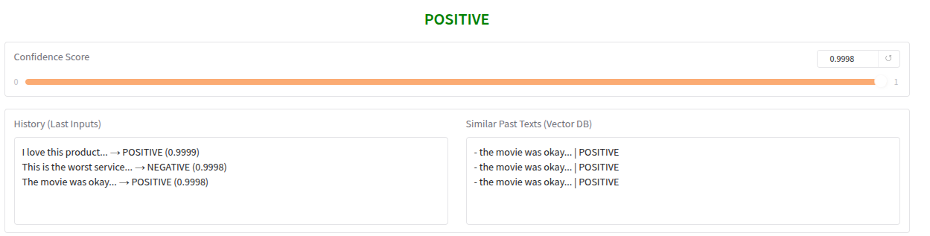
Results
Notes:
The system correctly predicts sentiment for different types of text.
Clear positive or negative sentences get high confidence scores.
Semantic search also works well and returns relevant similar texts.

Slide 9
Challenges & Learning
Large model download takes time
Docker build is slow due to model setup
Container networking setup
Learned real-world ML deployment
Notes:
During this project, I faced some practical challenges. One major challenge was that setting up the transformer models takes a long time. The model needs to be downloaded first, and because of the large size, the download process is slow.
Also, when building Docker images, the build process takes a lot of time because the models and dependencies need to be prepared properly. This made me understand how important model caching and correct Docker configuration are.
I also learned how different Docker containers communicate with each other. Overall, these challenges helped me understand real-world machine learning deployment better.

Slide 10
Conclusion & Demo
Project objectives achieved
Modern NLP system built
Live demo next
Notes:
In conclusion, this project successfully meets all the project requirements.
It uses modern NLP techniques, semantic search, and Docker deployment.
Now I will briefly show the code structure and demonstrate the live system.

Slide 11
Thank you.

